Slide 1



Adoption Guardianship Preparation Training
SESSION 4
This curriculum was developed by Harmony Family Center’s Adoption Support and Preservation Program in partnership with the Tennessee Department of Children’s Services.
1

Slide 2
Today We Will:
Learn what therapeutic parenting is
Use helpful strategies that support healing
Learn about the therapeutic web, including self-care and community support
Time for questions and reflection
2

Slide 3

3
Notes:
We only understand parenting in the context of our own experiences.
-We typically parent either how our own parents (or we've conciously made choices not to parent that way) or other parents in our community and culture parented
When we create a family, we have expectations, hopes and dreams.
The truth is that very few foster and adoptive parents are raising typically developing, strongly attached children who were well nurtured early in life or free from prenatal harm.
And for so many foster and adoptive families there’s (at least for a period of time) where we are parenting very differently than other folks in our families and communities
What we’re doing is sometimes
parenting kids who don’t understand why they live with us
Parenting kids with mental health challenges
It’s crisis parenting
And it can feel so overwhelming
Most of us create those expectations and understand the role of parenting in the context of typically developing, nurtured and kids without attachment injuries.

Slide 4


Therapeutic parenting gives kids both clear rules and lots of loving care.
It helps children who have been through trauma feel safe, connected, and ready to heal.
(Attachment and Trauma Network, 2023)
4
Notes:
Because we are doing something different, we need to parent differently as well.
As foster and adoptive parents, we often have to parent in a way that heals the past hurts that our kids have endured (loss of attachments, neglect, abuse, substance exposures, FASD/NAS). This is called therapeutic parenting.
ATN has an excellent definition of Therapeutic Parenting: a type of high structure/high nurture intentional parenting that fosters the feelings of safety and connectedness so that a traumatized child can begin to heal

Slide 5




Traditional Parenting
Therapeutic Parenting
Focuses on what the child is doing wrong
Focuses on the child’s strengths
5

Slide 6


Traditional Parenting
Therapeutic Parenting
Focuses on what the child is doing wrong
Focuses on the child’s strengths
Control based
Works with the child (cooperative)
6

Slide 7

7

Slide 8

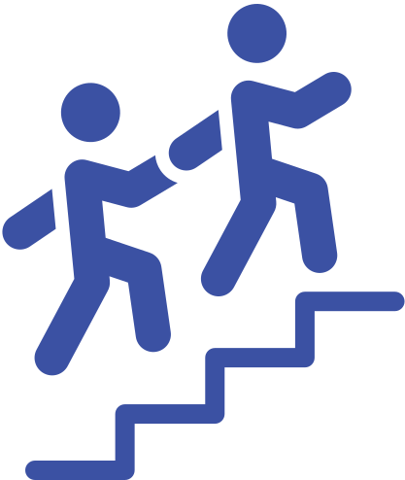
Traditional Parenting
Therapeutic Parenting
Focuses on What the Child is Doing Wrong
Focuses on the child’s strengths
Control based
Works with the child (cooperative)
Discipline is used to
make the child “pay” for their behavior
Discipline is used to
teach
8

Slide 9

9
Notes:
Therapeutic parenting is like building a house.
With typical parenting, you start decorating—picking colors, adding furniture, planning for the future.
But with therapeutic parenting, you have to start with the foundation.
That foundation is safety, connection, and emotional regulation.
If the foundation isn’t solid, nothing you build on top will last

Slide 10
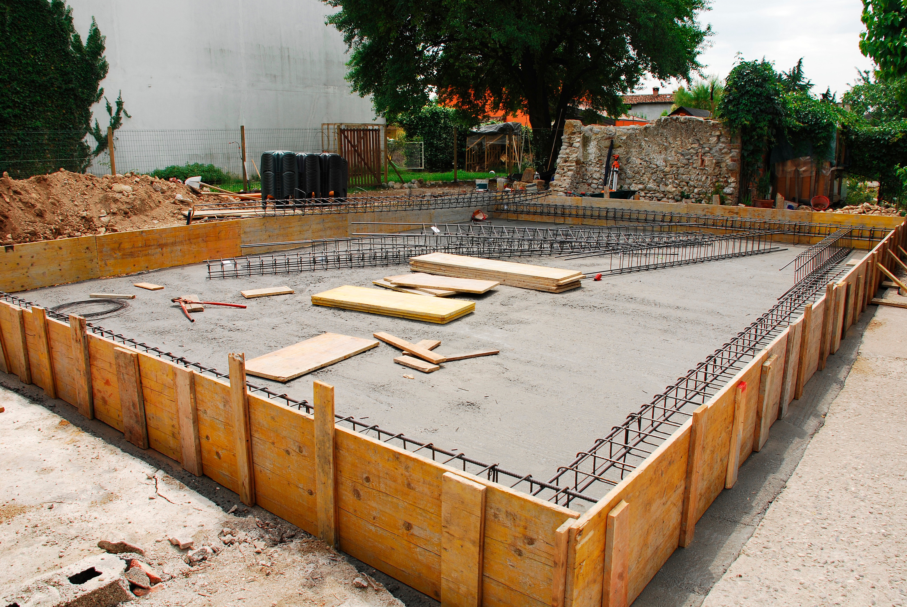


10
Notes:
Therapeutic parenting is like building a house.
With typical parenting, you start decorating—picking colors, adding furniture, planning for the future.
But with therapeutic parenting, you have to start with the foundation.
That foundation is safety, connection, and emotional regulation.
If the foundation isn’t solid, nothing you build on top will last

Slide 11



Physical Punishment is Not Safe or Helpful for Children with Trauma or Attachment Challenges
Teens who were hit or physically punished when they were young often feel more scared when they think they made a mistake.
Spanking can change how a child’s brain reacts to danger, similar to the effects of abuse.
Spanking is linked to more aggression.
(Finkelhor, Turner, Wormuth, Vanderminden, & Hamby, 2019)
(Burani, et al., 2023)
(Cuartas, Weissman, Sheridan, Lengua, & McLaughlin, 2021, p.829)
11

Slide 12

Therapeutic parenting changes how we look at behavior.
12

Slide 13
Misbehavior
is communication
can be a stress response in the brain and body
is often a lack of skill, not lack of effort
(Ablon, 2018)
13

Slide 14
14

Slide 15
15
Notes:
https://www.youtube.com/watch?v=c5OrowS5FT4

Slide 16



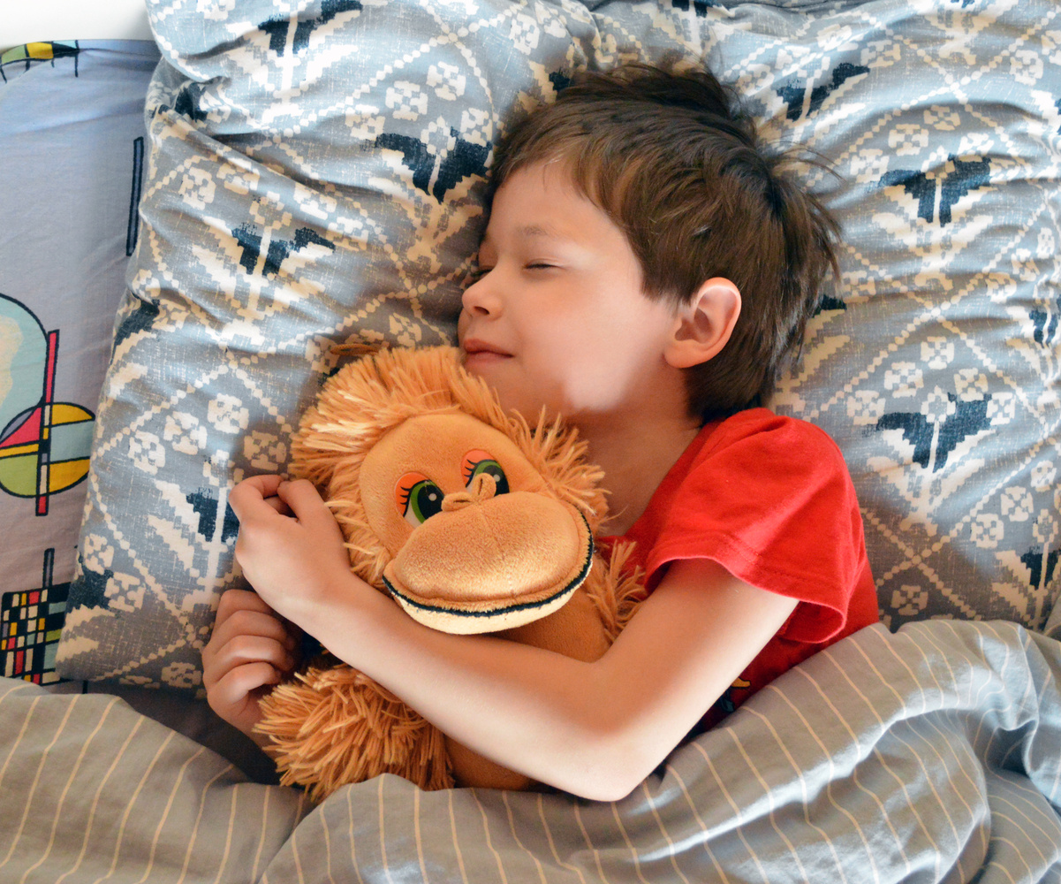

Felt safety means adults act in ways that help children feel sage in their body and mind.
(Purvis et al, 2007)
16

Slide 17


CREATING FELT SAFETY
hunger
thirst
energy/fatigue
body temperature
pain
using the bathroom
Inside
What is happening inside the body
17

Slide 18
CREATING FELT SAFETY
sight
smell
touch
taste
sound
other sensory systems
Outside
How the child experiences the world around them through:
18

Slide 19
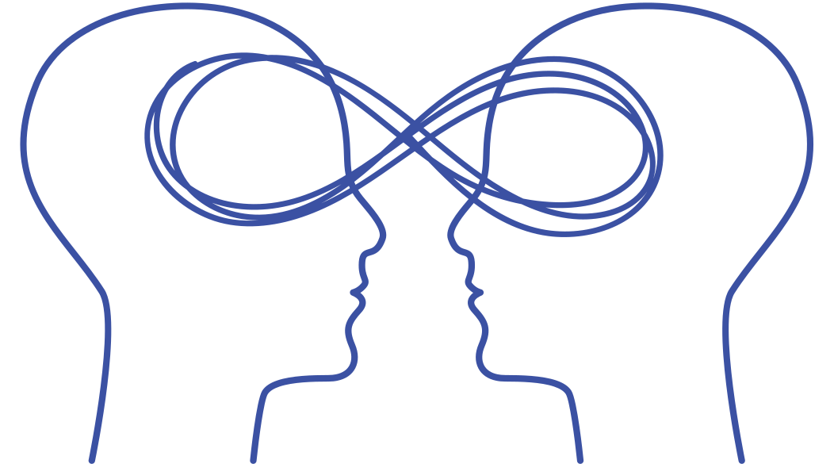
CREATING FELT SAFETY
Does this adult act in a safe way?
Is this adult stressed or angry?
Is this adult predictable?
Does this adult appreciate and love me?
Between
What is happening in relationships, children wonder:
19

Slide 20

CREATING FELT SAFETY
Lower stress when possible
Create simple daily routines
Give kids some choices
Notice what their bodies might need
Watch your face and tone of voice
(Purvis et al, 2007, pg. 48)
20

Slide 21
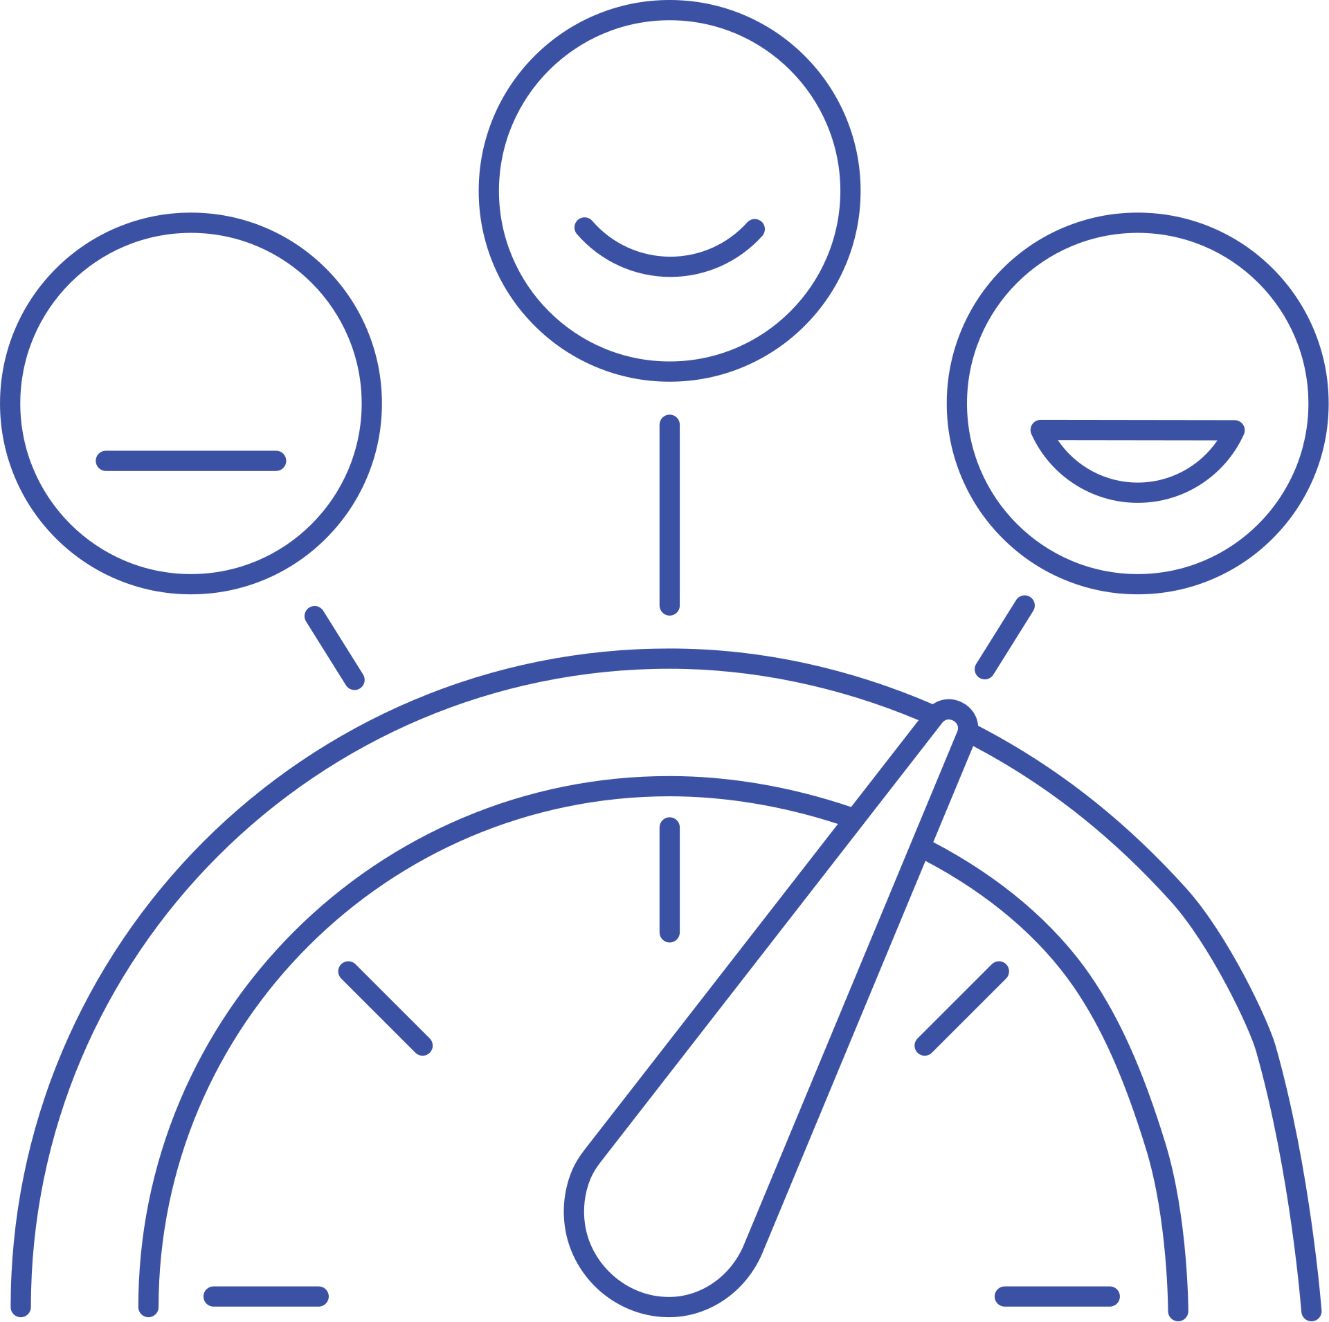


Therapeutic parents learn how the brain works so they can help kids feel safe, calm, and connected.
21

Slide 22
Regulate means adjusting your energy and actions to match what’s going on around you.
Regulate
Perry & Winfrey, What happened to you?: Conversations on trauma, resilience, and healing, 2021))
22

Slide 23
Regulate means adjusting your energy and actions to match what’s going on around you.
We can help kids manage trauma-based reactions like fight, run, freeze, or shut down, by using tools that help them feel safe and more in control.
Regulate
Perry & Winfrey, What happened to you?: Conversations on trauma, resilience, and healing, 2021))
23

Slide 24
Regulate means adjusting your energy and actions to match what’s going on around you.
We can help kids manage trauma-based reactions like fight, run, freeze, or shut down, by using tools that help them feel safe and more in control.
Being regulated doesn’t always mean being calm. It means the brain and body are working together in a way that fits the moment.
Regulate
Perry & Winfrey, What happened to you?: Conversations on trauma, resilience, and healing, 2021))
24

Slide 25



Ways to help kids regulate:
moving from a hard activity to something calming
snuggling under a weighted blanket
swinging in a hammock
taking a walk
jumping on a trampoline
offering a hug
relaxing shoulders and taking a deep breath
25

Slide 26
Relate means staying connected to the child while helping them stay regulated.
We do this by being safe, calm, and tuned in to their feelings.
Relate
Perry & Winfrey, What happened to you?: Conversations on trauma, resilience, and healing, 2021))
26

Slide 27



Showing empathy
Staying in control of our own reactions
Using a kind tone and gentle facial expressions
27

Slide 28
Reason means we help kids:
think about what happened
learn from it
talk about their feelings
build confidence
This is where teaching happens!
Reason
Perry & Winfrey, What happened to you?: Conversations on trauma, resilience, and healing, 2021))
28

Slide 29

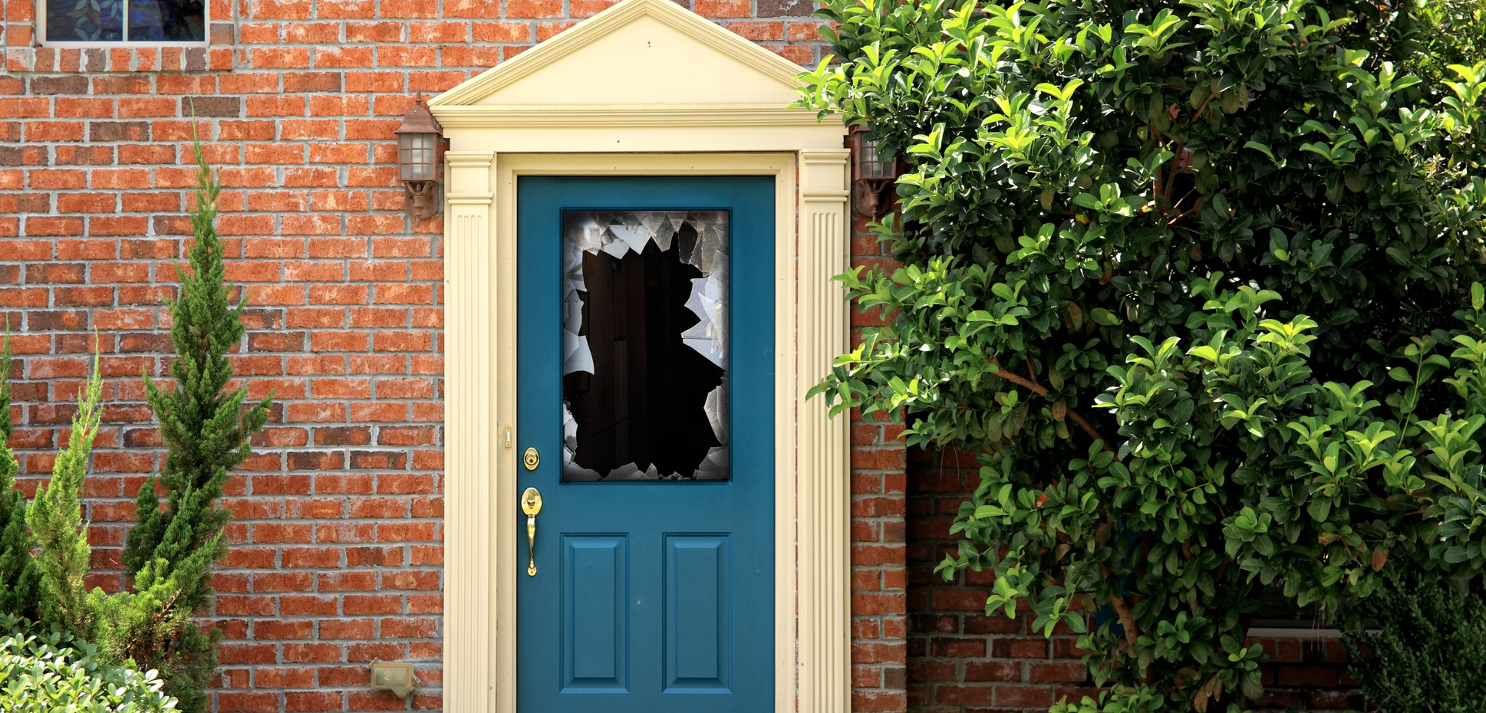

Teaching includes:
talking about what went wrong
understanding why the mistake happened
deciding what to do next time
repairing the mistake
29

Slide 30

(Douglas, 2021, p.4)
30
Notes:
“When my son was a preschooler, he had a particularly ugly meltdown in the grocery store.
As he lay kicking and screaming in the cereal aisle, I used every parenting technique I had been taught. I redirected, ignored, counted to 10, calmly explained the consequences of his actions, firmly explained the consequences of his actions, then angrily told him he was making me sad and that I was very, very disappointed in him.
Nothing worked and I was fuming. I finally picked him up, and left the store in a huff.”
“...as I described the situation to his therapist, complaining that my 4-year-old child with a history of neglect and food insecurity, “Just didn’t respond to reason,” the wise clinician placed her hand on top of mine and replied, “Yes, that’s true, but remember, you can’t teach a drowning child how to swim.”
She explained that what I saw as a defiant meltdown after being told no to sugary cereal in the grocery store was my son’s sensitized stress response system reacting to the fear of not getting his needs met.
I realized that my lectures, well-thought-out explanations, and attempts to convince him through the threat of consequences would never work. To have full access to the logical, rational parts of the brain, the low brain must be regulated.”

Slide 31


Resources for Therapeutic Parents
No Drama Discipline
Raising Kids with Big, Baffling Behaviors
The Connected Child
What Happened to You: Conversations on Trauma Resilience and Healing
by Daniel J. Siegel and Tina Payne Bryson
by Robyn Gobbel
by Karyn B. Purvis, David R. Cross, Wendy Lyons Sunshine
by Oprah Winfrey, Bruce D. Perry, M.D., Ph.D.
Empowered to Connect Podcast
Good Inside with Dr. Becky Podcast
31

Slide 32
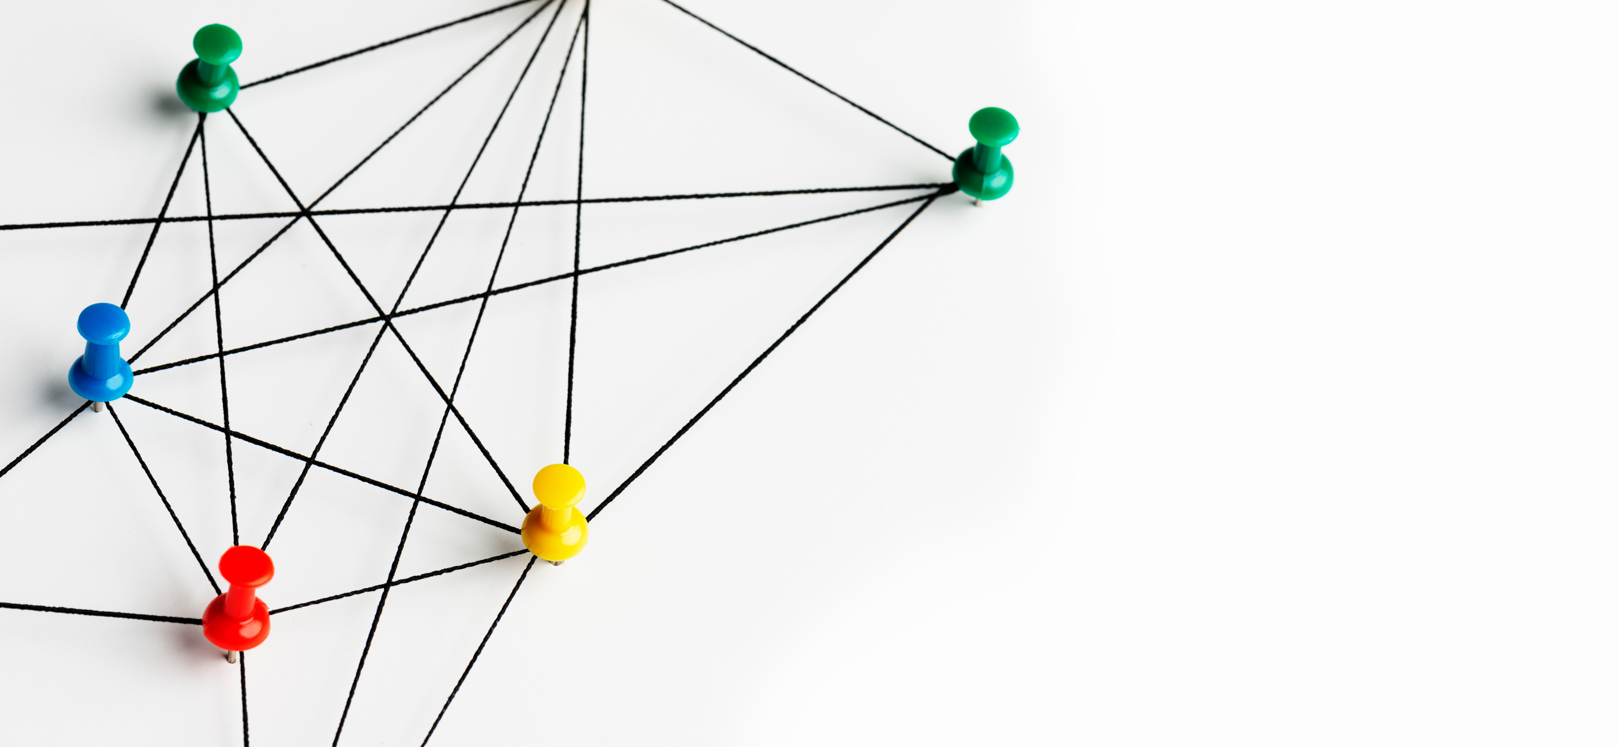
Family and Friends
Therapists
Coaches
Mentors
Babysitters
Medical providers
The Therapeutic Web
32

Slide 33

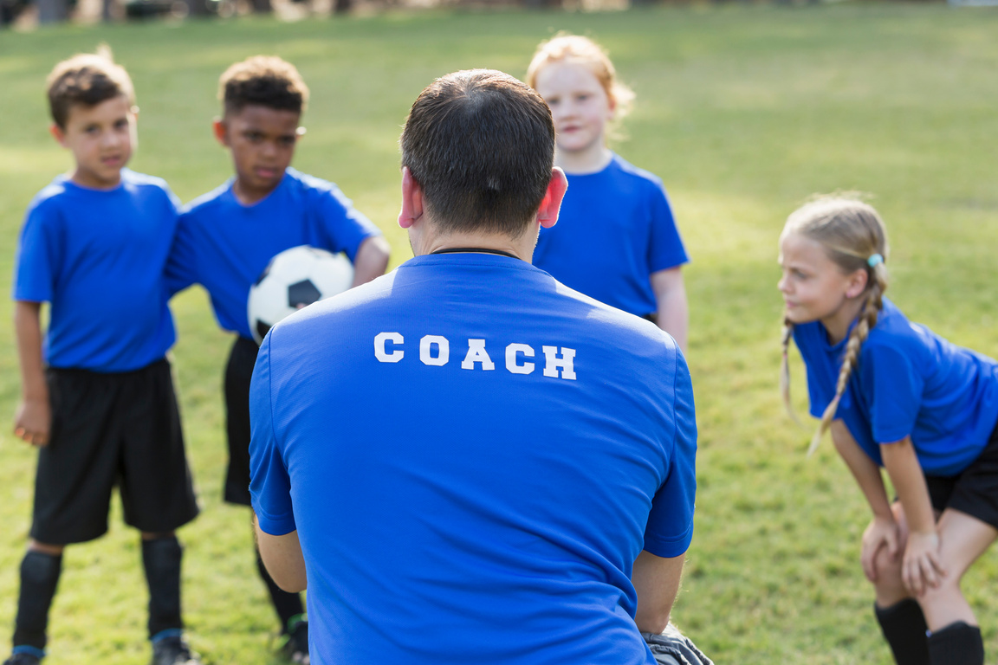
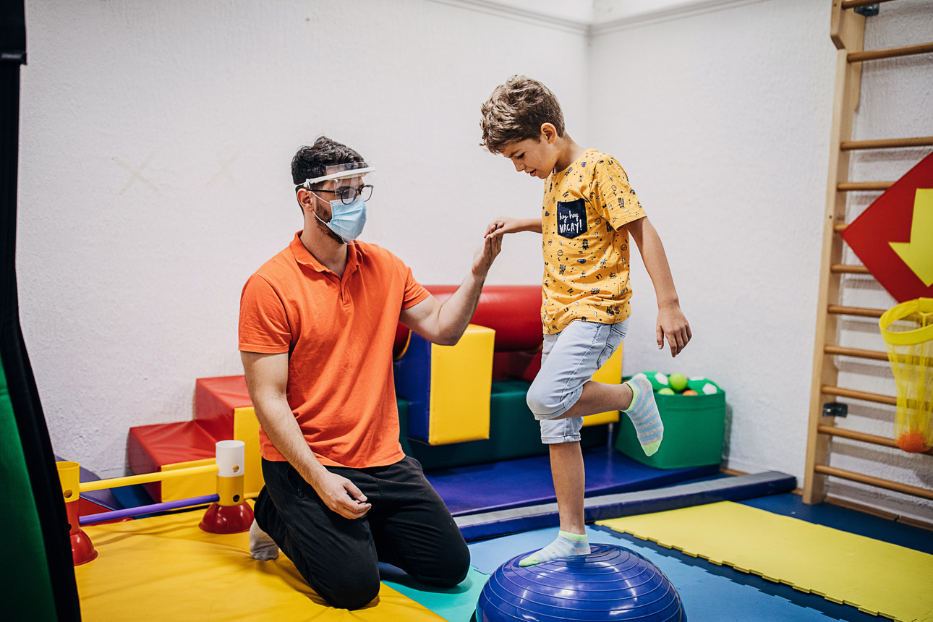
Primary Resources
33

Slide 34

Primary Resources
Community Resources
34

Slide 35
Primary Resources
Community Resources
Professional Resources
35

Slide 36

Let’s
Discuss!
36

Slide 37
Community and Self Care
37

Slide 38

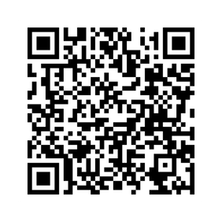
For more information about Tennessee’s post permanency services scan the QR code.
38

Slide 39

Thanks for completing this session!
Thank you for your time, your courage, and your heart.
The adoption/SPC journey continues, but you are not alone. You’ve taken an important step for yourself and your family.
39

Slide 40

References
Burani, K., Brush, C., Spahr, C., Slavich, G. M., Meyer, A., & Hajcak, G. (2023). Corporal Punishment Is Uniquely Associated With a Greater Neural Response to Errors and Blunted Neural Response to Rewards in Adolescence. Biological Psychiatry: Cognitive Neuroscience and Neuroimaging, 210-218 https://doi.org/10.1016/j.bpsc.2022.09.004.
Cuartas, J., Weissman, D. G., Sheridan, M. A., Lengua, L., & McLaughlin, K. A. (2021). Corporal Punishment and Elevated Neural Response to Threat in Children. Child Development, 821–832 doi:10.1111/cdev.13565.
Douglas, A. C. (2021, November). Meeting Children Where They Are: The Neurosequential Model of Therapeutics. Adoption Advocate Number 161, pp. 2-9.
Finkelhor, D., Turner, H., Wormuth, B. K., Vanderminden, J., & Hamby, S. (2019). Corporal Punishment: Current Rates from a National Survey. Journal of Child and Family Studies, 1991–1997 DOI https://doi.org/10.1007/s10826-019-01426-4.
Gobbel, R. (2024). Raising Kids with Big, Baffling Behaviors . London: Jessica Kingsley Publishers.
Perry, B. D. (2009). Examining Child Maltreatment Through a Neurodevelopmental Lens: Clinical Applications of the Neurosequential Model of Therapeutics. Journal of Loss and Trauma,, 240–255 DOI: 10.1080/15325020903004350.
Perry, B. D., & Winfrey, O. (2021). What happened to you?: Conversations on trauma, resilience, and healing. New York: Flatiron Books.
Purvis , K. B., Cross, D. R., & Sunshine, W. L. (2007). Disarming the Fear Response. In The Connected Child (pp. 47-72). New York: McGraw Hill.
Understanding the Senses: Proprioception. (2023, December 5). Retrieved from Pathways.org: https://pathways.org/what-is-the-proprioception-sense/
40

