Slide 1



Adoption Guardianship Preparation Training
SESSION 2
This curriculum was developed by Harmony Family Center’s Adoption Support and Preservation Program in partnership with the Tennessee Department of Children’s Services.
1

Slide 2
Today We Will:
Learn how traumatic experiences can affect how kids grow and learn.
Talk about the 7 Core Issues in Permanency, or feelings adopted or guardian families may go through.
Share ideas on how adults can help kids heal, feel safe, and become stronger.
Have time for questions and reflection.
2

Slide 3

All children that have been adopted or are in guardianship have experienced trauma.
3

Slide 4

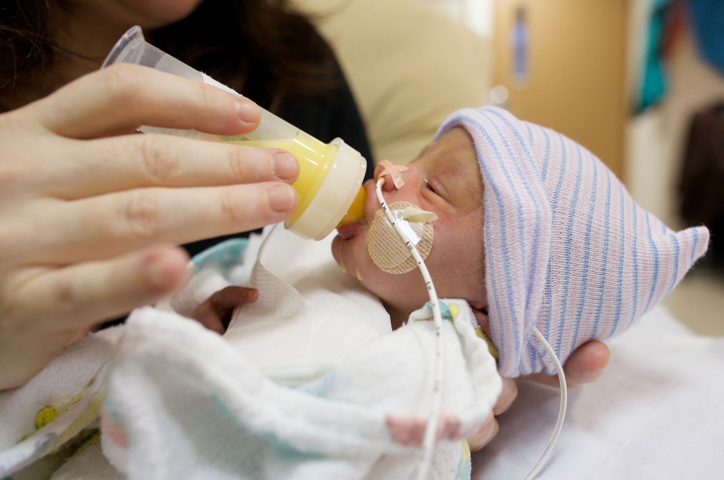


Challenges during pregnancy
being exposed to drugs or alcohol before birth
mother being very stressed
not getting enough healthy food
Trauma around birth
being born early
unsafe birth
medical treatments that hurt
separation from a birth parent
Relationship-based trauma
care that changes a lot
child being ignored or with unmet needs
having a caregiver die
Trauma from abuse or unsafe environments
physical, emotional, or sexual abuse
seeing violence
not having a safe place to live or living through a disaster
4

Slide 5



Trauma happens when a child goes through something that makes them feel really scared, like they might get hurt or die.
(American Psychiatric Association, 2013, p.271)
5

Slide 6
Complex trauma is when a child goes through many scary or hurtful experiences, especially when the people who are supposed to take care of them are the ones causing harm.
(The National Child Traumatic Stress Network, 2018)
6
Notes:
“Complex trauma describes...children’s exposure to multiple traumatic events...(that) are severe and pervasive, such as abuse or profound neglect. They usually occur early in life and can disrupt many aspects of the child’s development and the formation of a sense of self. Since these events often occur with a caregiver, they interfere with the child’s ability to form a secure attachment.”

Slide 7


7
Notes:
Most trauma events have a distinct beginning and end point
C-PTSD is more complicated

Slide 8

Complex trauma can change every part of a child’s development.
Including how they
think
feel
grow
get along with others
8

Slide 9
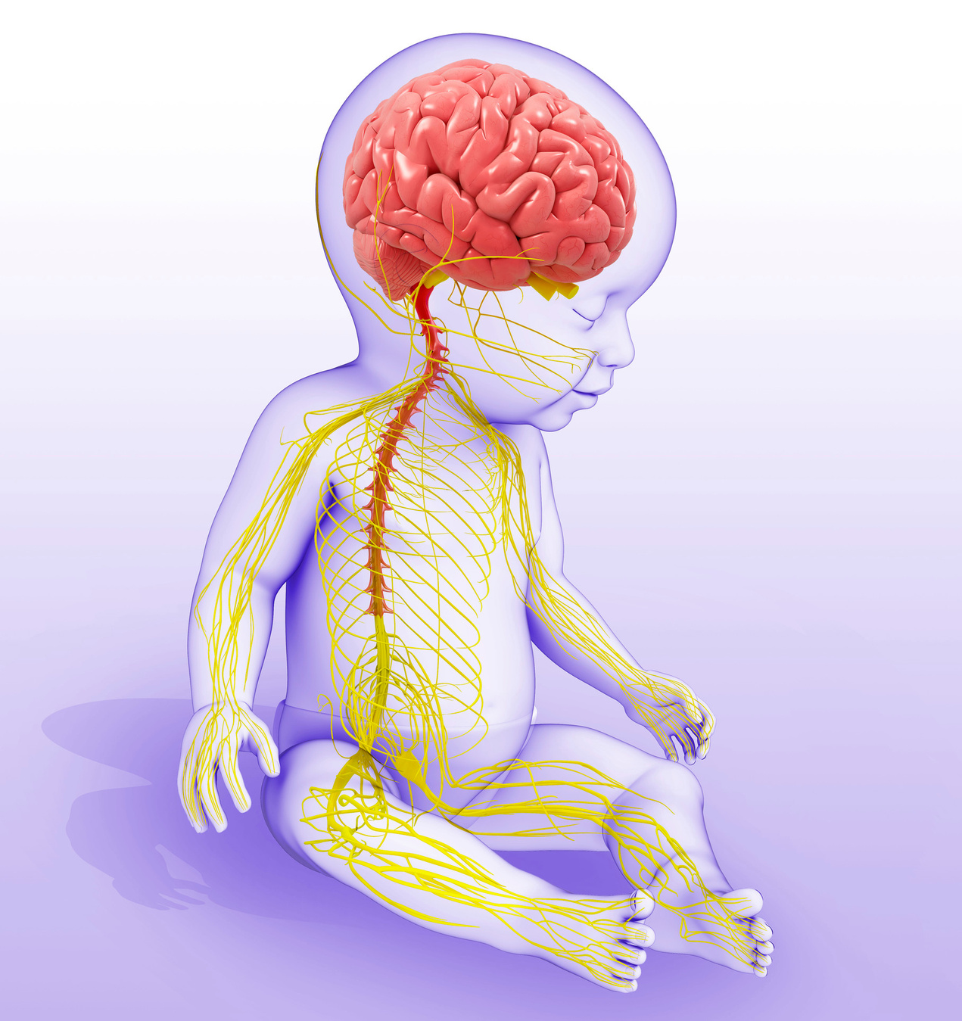
Brain
Easily upset or stressed
Problems with higher level thinking skills like keeping things in order or finishing work
Trouble remembering things
9
Notes:
Brain- cognitive

Slide 10

10

Slide 11

Biology
Trouble falling asleep or staying asleep
Changes in how the body uses food and energy
Long-term changes in how the body and brain work, caused by stress and passed on to children, grandchildren and future generations, called epigenetic changes.
11
Notes:
Brain- cognitive

Slide 12
12

Slide 13

Behavior
Has trouble thinking before acting
Often feels out of control or feeling too much at once
Feels anxious, worried, or sad a lot
Has trouble following directions
Acts out with anger or aggression
13
Notes:
Brain- cognitive

Slide 14
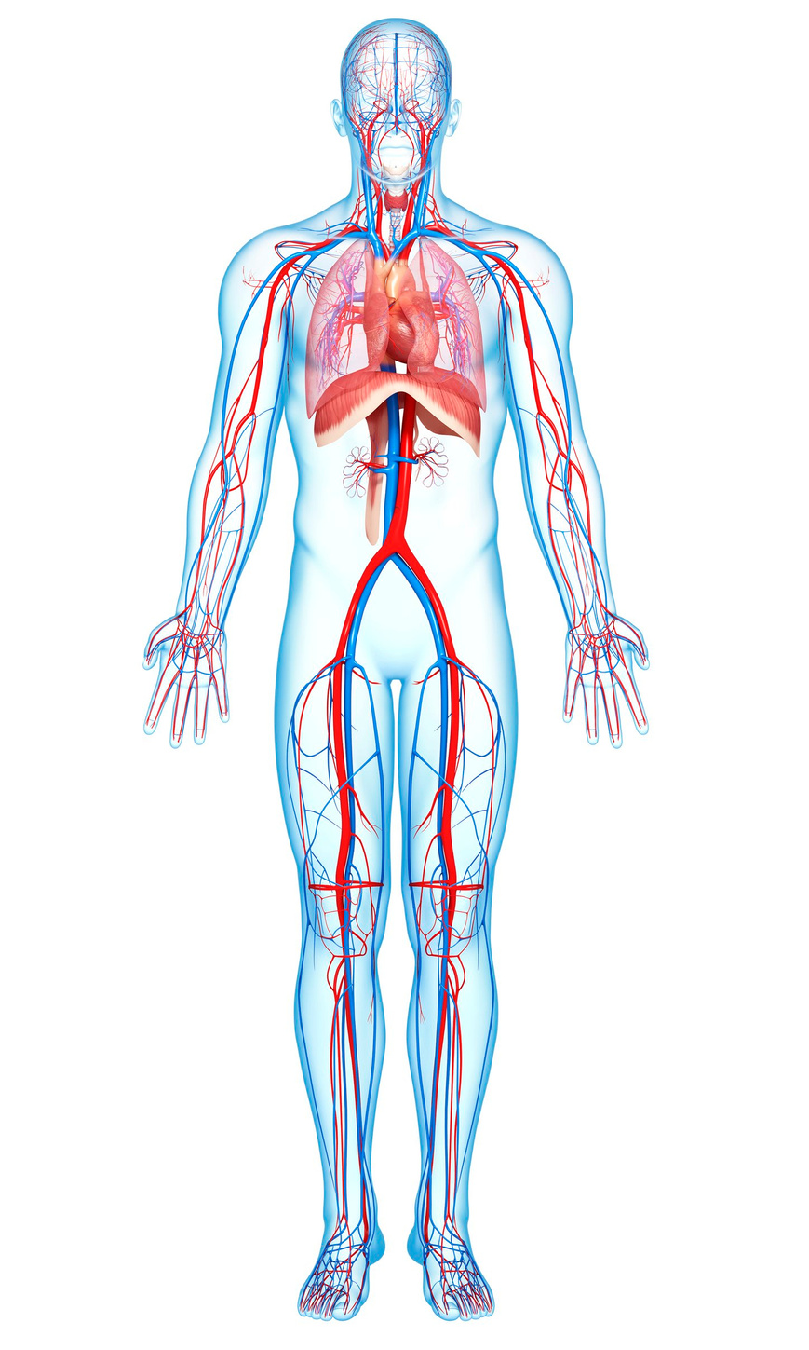
Body
Stomach problems, like pain or digestion issues
Strong reactions to sound, touch, or other senses
Heart that beats too fast or too slow
More likely to have health problems like cancer, liver disease, or broken bones
14
Notes:
Brain- cognitive

Slide 15
15

Slide 16

Beliefs
Feels bad about themselves
Has a hard time trusting people
Feels like the world is a scary, bad, or unsafe place
16
Notes:
Brain- cognitive

Slide 17
17

Slide 18


Seven Core
Issues in
Adoption
and Permanency
Loss
(Roszia & Maxon, 2019)
18

Slide 19


Rejection
Loss
19
(Roszia & Maxon, 2019)

Slide 20



What Your Child May Experience
Infant
Childhood
Teen
Problems attaching
Fear of being alone
Struggles when they feel left out or different
People pleasing behaviors to avoid problems
Really wants to fit in and often goes along with what others are doing. May act differently depending on who they are with.
May avoid trying new things because they are afraid others won’t accept them.
May have confusing or up-and-down dating relationships.
20

Slide 21

Adoptive and guardianship families may feel hurt or rejected when
their child pulls away from their hugs or closeness
the child feels connected and close to their birth family
their child wants to find their birth family or learn more about who they are
21

Slide 22

Shame & Guilt
Rejection
Loss
22
(Roszia & Maxon, 2019)

Slide 23
What Your Child May Experience
May not express needs due to mistrust of self and adults
Infant
Childhood
Teen
Anxiety and unhealthy people-pleasing to keep others happy.
Believes being separated from their birth family means they are bad, not loved, or something is wrong with them.
Believes they must be perfect to be loved, which can cause worry, low self-worth, and perfectionism.
Shame can show up as anger or acting aggressive.
May hide shame by acting like they don’t care or by shutting down their feelings.
May hurt themselves or use drugs when they feel overwhelmed.
23

Slide 24
Adoptive and guardianship families may feel shame or guilt when
they can not “fix” the impact of trauma in a child’s life
they can not take away a child’s pain
24

Slide 25

Grief
Rejection
Shame & Guilt
Loss
25
(Roszia & Maxon, 2019)

Slide 26
What Your Child May Experience
Infant
Childhood
Teen
More anxiety and getting annoyed easily.
Not feeling hungry or not wanting to eat.
More anxiety and getting annoyed easily.
Acting out or breaking rules.
Feeling very sad or down.
Having stomachaches or headaches.
Being overly active or unable to sit still.
Feeling irritated, angry, or very upset.
Feeling depressed or really sad.
May avoid tough feelings by staying busy or keeping themselves distracted.
Feeling sad again when something reminds them, like birthdays or holidays.
26

Slide 27
Adoptive and guardianship families may experience grief when
Their child wants to learn more about or meet their birth family.
Their child’s growth and behavior are affected by past trauma.
Their child feels sad about their birth family during big life events.
They may still wish they had a biological child.
27

Slide 28

Identity
Rejection
Shame & Guilt
Loss
Grief
28
(Roszia & Maxon, 2019)

Slide 29



What Your Tween or Teen May Experience
Feeling out of place, like they don’t truly fit in with any group or family
Feeling unknown and unwanted
Not liking how their body looks
Missing parts of who they are, like family history or culture
29
Notes:
Teens are figuring out who they are, and this often shows up in strong and sometimes confusing ways during this stage of development.
You may notice your child “trying on” different identities or having a hard time figuring out who they are and who they want to become.

Slide 30
Adoptive and guardianship families may experience identity struggles when
The loss of privacy in adoption comes up again and again.
They worry they are not “enough” for their child.
Their child says they don’t always feel like they belong in the family.
Their child connects strongly with their own culture or race
30

Slide 31

Intimacy
Rejection
Shame & Guilt
Loss
Grief
Identity
31
(Roszia & Maxon, 2019)

Slide 32
What Your Child May Experience
Infant
Childhood
Teen
Has a hard time forming healthy, close relationships.
May be hard to comfort or calm down.
May be slow to trust or build close relationships with friends, teachers, or others.
May hold back their feelings with family because they worry about being left or feel uncomfortable with closeness.
May push away or ruin close friendships or dating relationships.
May move from one relationship to another very quickly.
May look for closeness in unsafe ways or in ways that are too sexual for their age.
32

Slide 33
Adoptive and guardianship families may
Find it hard to parent a child who avoids showing feelings or holds back emotionally.
Feel overwhelmed or unsure how to handle their child’s big emotions or emotional needs.
33

Slide 34


Mastery & Control
Rejection
Shame & Guilt
Loss
Intimacy
Grief
Identity
34
(Roszia & Maxon, 2019)

Slide 35
What Your Child May Experience
Infant
Childhood
Teen
Loss of control in early life can lead to problems with learning, behavior, or emotions as they grow up
A deep need for independence
Lack of cause and effect thinking
Fear of change
Inflexible behaviors
Need to challenge adults
Need to be “right”
Trying too hard to be perfect
Need to be in charge or control others
May feel like life just happens to them and act as if their choices don’t matter or they have no role in what happens.
35

Slide 36
Adoptive and guardianship families may
struggle to feel confident in parenting and meeting child’s needs
struggle with idea that this is not how they envisioned parenting/family
struggle with lack of control related to impacts of trauma on child’s behavior or development
36

Slide 37

Adoptive and Guardianship Parents Must
Understand that past experiences will still affect their child.
37
Notes:
Can not assume that love will fix things

Slide 38

Adoptive and Guardianship Parents Must
Understand that past experiences will still affect their child
Help their child stay strong and resilent
38
Notes:
Positive childhood experiences show dose-response associations with D/PMH and ARSES after accounting for exposure to ACEs. The proactive promotion of PCEs for children may reduce risk for adult D/PMH and promote adult relational health. Joint assessment of PCEs and ACEs may better target needs and interventions and enable a focus on building strengths to promote well-being. Findings support prioritizing possibilities to foster safe, stable nurturing relationships for children that consider the health outcomes of positive experiences.
AMA Pediatr. 2019;173(11):e193007. doi:10.1001/jamapediatrics.2019.3007 Published online September 9, 2019. Corrected on September 30, 2019.

Slide 39
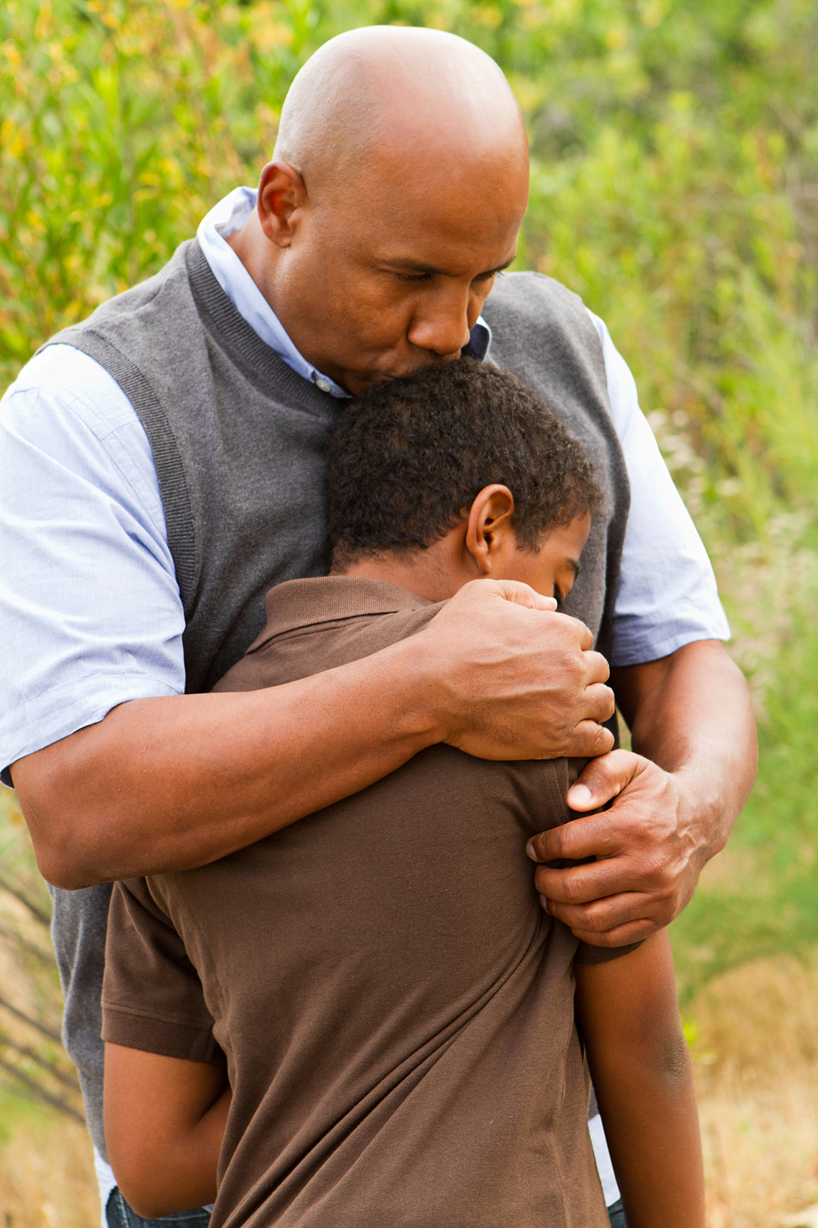


feeling able to talk to your family about your emotions
feeling your family stood by you during difficult times
enjoying participation in community traditions
feeling a sense of belonging in school
feeling supported by friends
having at least two non-parent adults who take a genuine interest in you
feeling safe and protected by an adult in your home
39
·(Bethell, Jones, Gombojav, Linkenbach, & Sege, 2019, p. 6)

Slide 40

Adoptive and Guardianship Parents Must
Understand that past experiences will still affect their child
Try to understand why their child
acts a certain way
Help their child stay strong and resilent
40

Slide 41

Adoptive and Guardianship Parents Must
Understand that past experiences will still affect their child
Try to understand why their child
acts a certain way
Be open to seeking out help
Help their child stay strong and resilent
41

Slide 42

Let’s Discuss
42

Slide 43
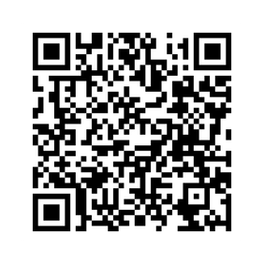

Harmony is here,
providing information, resources and services when you need them.
43

Slide 44
References
American Psychiatric Association. (2013). Diagnostic and statistical manual of mental disorders (5th ed.).
Bethell, C., Jones, J., Gombojav, N., Linkenbach, J., & Sege, R. (2019). Positive Childhood Experiences and Adult Mental and Relational Health in a Statewide Sample Associations Across Adverse Childhood Experiences Levels. JAMA Pediatrics, Published online September 9, 2019. Corrected on September 30, 2019.
Leve, L. D., Oro, V., Natsu, M. N., Harold, G. T., Neiderhise, J. M., Ganiban, J. M., . . . DeGarmo, D. S. (2024). The pernicious role of stress on intergenerational continuity of psychopathology. Development and Psychopathology, 1-14
doi:10.1017/S0954579424000191.
Roszia, S., & Maxon, A. (2019). Seven Core Issues in Adoption and Permanency Davis. Seven Core Issues in Adoption and Permanency. Jessica Kingsley Publishers. Kindle Edition. London: Jessica Kingsley.
The National Child Traumatic Stress Network. (2018, May 25). Complex Trauma. Retrieved from The National Child Traumatic Stress Network: https://www.nctsn.org/what-is-child-trauma/trauma-types/complex-trauma
The National Quality Improvement Center for Adoption and Guardianship. (2018). The Continuing Journey of Children and Families An Informational Guide for those Parenting by Adoption or Guardianship. The Children's Bureau.
44

