Slide 1



AGPT SESSION 4
Trainer Name and Credentials

Slide 2

Objectives
  Introduction to therapeutic parenting
  Therapeutic parenting strategies
  The Therapeutic Web and self/community care
  Questions and reflections

Slide 3

Notes:
We only understand parenting in the context of our own experiences.
-We typically parent either how our own parents (or we've conciously made choices not to parent that way) or other parents in our community and culture parented
When we create a family, we have expectations, hopes and dreams.
The truth is that very few foster and adoptive parents are raising typically developing, strongly attached children who were well nurtured early in life or free from prenatal harm.
And for so many foster and adoptive families there’s (at least for a period of time) where we are parenting very differently than other folks in our families and communities
What we’re doing is sometimes
parenting kids who don’t understand why they live with us
Parenting kids with mental health challenges
It’s crisis parenting
And it can feel so overwhelming
Most of us create those expectations and understand the role of parenting in the context of typically developing, nurtured and kids without attachment injuries.

Slide 4

Therapeutic Parenting: a type of high structure/high nurture, intentional parenting, that fosters the feelings of safety and connectedness so that a traumatized child can begin to heal.
-Attachment and Trauma Network
(Attachment and Trauma Network, 2023)
Notes:
Because we are doing something different, we need to parent differently as well.
As foster and adoptive parents, we often have to parent in a way that heals the past hurts that our kids have endured (loss of attachments, neglect, abuse, substance exposures, FASD/NAS). This is called therapeutic parenting.
ATN has an excellent definition of Therapeutic Parenting: a type of high structure/high nurture intentional parenting that fosters the feelings of safety and connectedness so that a traumatized child can begin to heal

Slide 5




Traditional Parenting
Therapeutic Parenting
Deficit Model
Strengths Based Model

Slide 6


Traditional Parenting
Therapeutic Parenting
Deficit Model
Strengths Based Model
Control Based
Collaborative

Slide 7


Slide 8


Traditional Parenting
Therapeutic Parenting
Deficit Model
Strengths Based Model
Control Based
Collaborative
Discipline is to
Make Child “Pay”
Discipline is to
Teach

Slide 9

Typical parenting is future oriented- it’s all about teaching, instilling values, and growing character; but therapeutic parenting is firmly bound in the present. The focus is on feeling safe, connected, and regulated. Then, and only then, can the growth begin.

Slide 10




Corporal Discipline is Not Appropriate for Children with Trauma or Attachment Wounds
Teens subjected to corporal discipline in their childhood, show increased activation of anxiety when they perceive they are making a mistake.
Spanking may alter the brain’s responses to perceived threat in a manner much like abuse or maltreatment
“Spanking is associated with...higher levels of subsequent aggression.”
(Finkelhor, Turner, Wormuth, Vanderminden, & Hamby, 2019, p. 1991)
(Burani, et al., 2023)
(Cuartas, Weissman, Sheridan, Lengua, & McLaughlin, 2021, p.829)

Slide 11


Slide 12
Misbehavior
  is communication
  may be based in the biological
  is often a lack of skill, not will
(Ablon, 2018)

Slide 14
Notes:
https://www.youtube.com/watch?v=c5OrowS5FT4

Slide 15

Felt safety means “…adults arrange the environment and adjust their behavior so children can feel in a profound and basic way that they are truly safe…”
(Purvis et al, 2007, pg. 48)

Slide 16

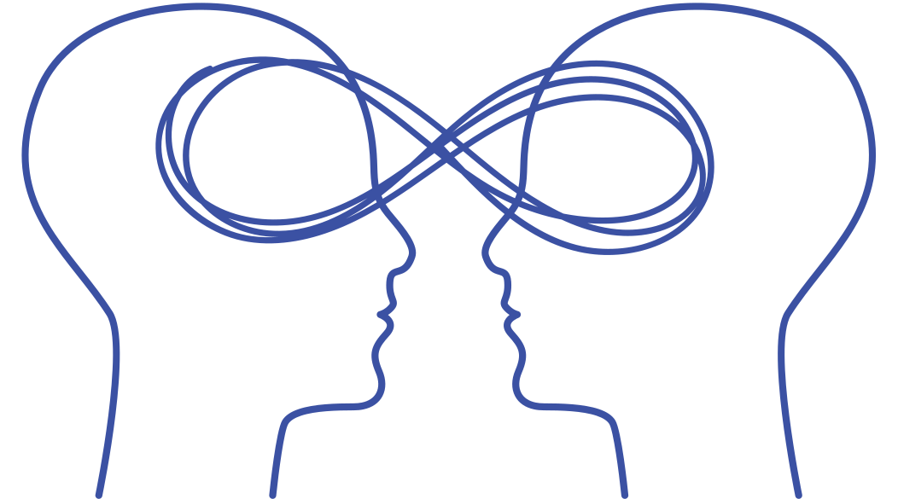

CREATING FELT SAFETY
Inside
Outside
Between
What is happening inside the body:
  hunger
  thirst
  fatigue
  body temperature
  pain
  need to use the bathroom

Slide 17
CREATING FELT SAFETY
Inside
Outside
Between
What is happening inside the body:
  hunger
  thirst
  fatigue
  body temperature
  pain
  need to use the restroom
The child’s environment as perceived through:
  sight
  smell
  touch
  taste
  sound
  the vestibular system
  the proprioceptive system

Slide 18
CREATING FELT SAFETY
Inside
Outside
Between
What is happening inside the body:
  hunger
  thirst
  fatigue
  body temperature
  pain
  need to use the restroom
The child’s environment as perceived through:
  sight
  smell
  touch
  taste
  sound
What is happening relationally:
  Does this adult behave in a way that feels safe?
  Is this adult frightened, stressed, or angry?
  Is this adult predictable and consistent?
  Am I appreciated and cherished by this adult?
  the vestibular system
  the proprioceptive system

Slide 19

CREATING FELT SAFETY
  Reduce stress
  Build routines
  Share control
  Be aware of physical needs
  Be aware of facial expressions and tone of voice
(Purvis et al, 2007, pg. 48)

Slide 20



Therapeutic parents use a brain-wise approach.

Slide 21
  transitioning from the dysregulating activity and snuggling under a weighted blanket
  swinging in a hammock
  taking a walk
  jumping on a trampoline
  offering a hug
  relaxing shoulders and taking a deep breath
Regulate
Perry & Winfrey, What happened to you?: Conversations on trauma, resilience, and healing, 2021))

Slide 22




Slide 23
  showing empathy
  modulating reactions to behaviors
  maintaining a nurturing tone and facial expression
Relate
Perry & Winfrey, What happened to you?: Conversations on trauma, resilience, and healing, 2021))

Slide 24




Slide 25
  reflecting on inappropriate behavior
  talking about what went wrong
  understanding why the mistake was made
  deciding how to handle the situation in the future
  repairing mistakes and making amends
Reason
Perry & Winfrey, What happened to you?: Conversations on trauma, resilience, and healing, 2021))

Slide 26




Slide 27

“When my son was a preschooler, he had a particularly ugly meltdown in the grocery store.
As he lay kicking and screaming in the cereal aisle, I used every parenting technique I had been taught. I redirected, ignored, counted to 10, calmly explained the consequences of his actions, firmly explained the consequences of his actions, then angrily told him he was making me sad and that I was very, very disappointed in him.
Nothing worked and I was fuming. I finally picked him up, and left the store in a huff.”
(Douglas, 2021, p.4)

Slide 28
“...as I described the situation to his therapist, complaining that my 4-year-old child with a history of neglect and food insecurity, “Just didn’t respond to reason,” the wise clinician placed her hand on top of mine and replied, “Yes, that’s true, but remember, you can’t teach a drowning child how to swim.”
She explained that what I saw as a defiant meltdown after being told no to sugary cereal in the grocery store was my son’s sensitized stress response system reacting to the fear of not getting his needs met.
I realized that my lectures, well-thought-out explanations, and attempts to convince him through the threat of consequences would never work. To have full access to the logical, rational parts of the brain, the low brain must be regulated.”
(Douglas, 2021, p.4)

Slide 29



Resources for Therapeutic Parents
  No Drama Discipline
  Raising Kids with Big, Baffling Behaviors
  The Connected Child
  What Happened to You: Conversations on Trauma Resilience and Healing
by Daniel J. Siegel and Tina Payne Bryson
by Robyn Gobbel
by Karyn B. Purvis, David R. Cross, Wendy Lyons Sunshine
by Oprah Winfrey, Bruce D. Perry, M.D., Ph.D.
  Empowered to Connect Podcast
  Good Inside with Dr. Becky Podcast
  https://beaconhouse.org.uk/resources
  @EmpoweredtoConnect YouTube channel

Slide 30

The Therapeutic Web

Slide 31


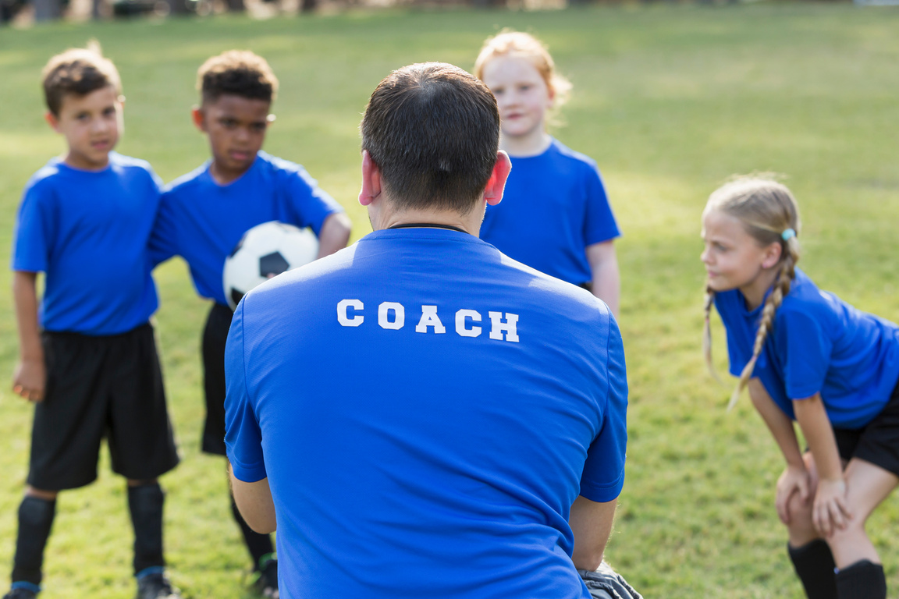
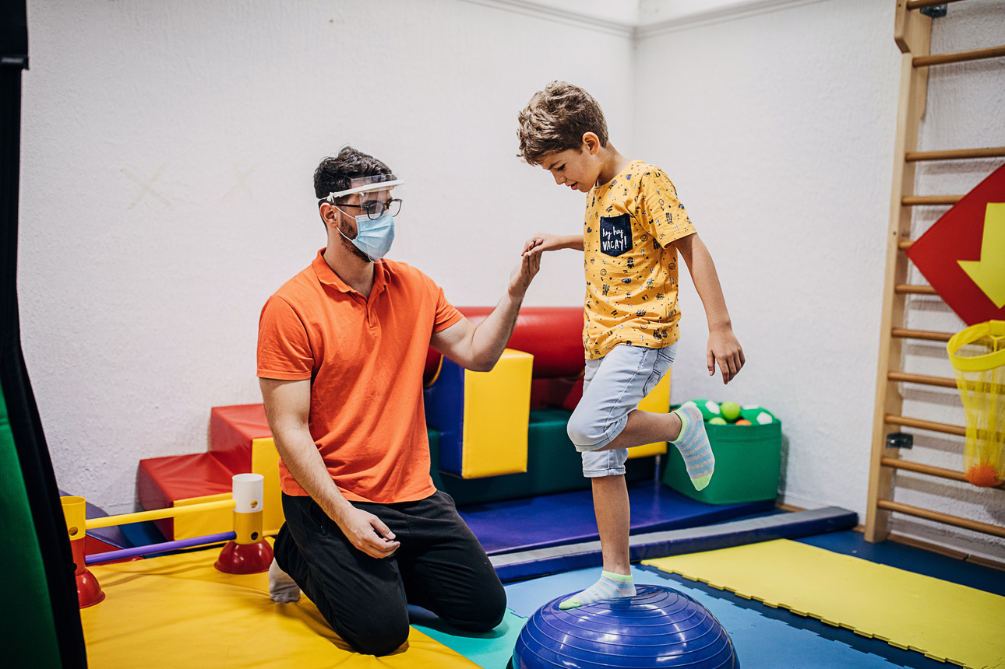

Primary Resources

Slide 32
Primary Resources
Community Resources

Slide 33
Primary Resources
Community Resources
Professional Resources

Slide 34

Reflection and Discussion

Slide 35
Community and Self Care

Slide 36
References
Burani, K., Brush, C., Spahr, C., Slavich, G. M., Meyer, A., & Hajcak, G. (2023). Corporal Punishment Is Uniquely Associated With a Greater Neural Response to Errors and Blunted Neural Response to Rewards in Adolescence. Biological Psychiatry: Cognitive Neuroscience and Neuroimaging, 210-218 https://doi.org/10.1016/j.bpsc.2022.09.004.
Cuartas, J., Weissman, D. G., Sheridan, M. A., Lengua, L., & McLaughlin, K. A. (2021). Corporal Punishment and Elevated Neural Response to Threat in Children. Child Development, 821–832 doi:10.1111/cdev.13565.
Douglas, A. C. (2021, November). Meeting Children Where They Are: The Neurosequential Model of Therapeutics. Adoption Advocate Number 161, pp. 2-9.
Finkelhor, D., Turner, H., Wormuth, B. K., Vanderminden, J., & Hamby, S. (2019). Corporal Punishment: Current Rates from a National Survey. Journal of Child and Family Studies, 1991–1997 DOI https://doi.org/10.1007/s10826-019-01426-4.
Gobbel, R. (2024). Raising Kids with Big, Baffling Behaviors . London: Jessica Kingsley Publishers.
Perry, B. D. (2009). Examining Child Maltreatment Through a Neurodevelopmental Lens: Clinical Applications of the Neurosequential Model of Therapeutics. Journal of Loss and Trauma,, 240–255 DOI: 10.1080/15325020903004350.
Perry, B. D., & Winfrey, O. (2021). What happened to you?: Conversations on trauma, resilience, and healing. New York: Flatiron Books.
Purvis , K. B., Cross, D. R., & Sunshine, W. L. (2007). Disarming the Fear Response. In The Connected Child (pp. 47-72). New York: McGraw Hill.
Understanding the Senses: Proprioception. (2023, December 5). Retrieved from Pathways.org: https://pathways.org/what-is-the-proprioception-sense/

